Slide 1
Enhancement of Night Vision IR Images
Aadesh Desai 19110116
Eshan Gujarathi 19110082
Saagar Parikh 19110199
Sanjay Venkitesh 19110200

Slide 2
Project Brief
Aim: To apply image enhancement algorithms on Night vision IR images using Vivado.
Algorithms:
Histogram Equalisation
Histogram Matching
Double Plateau Histogram Equalization
Top Hat Transform
These algorithms perform contrast enhancement on the image.
Dataset: ir:iricra2014 – ASL Datasets

Slide 3
Weekly Plan
Week 1: Implementing Histogram Equalisation and Histogram Matching on Python.
Week 2: Implementing Double Plateau Histogram Equalization and Top Hat Transform on Python.
Week 3:
Compare the results of the different algorithms and select the ones that need to be implemented on Verilog.
Reading images on Vivado
Week 4: Complete the Verilog implementation of the selected algorithms.

Slide 4
Sequence of tasks implemented
Implementing all four algorithms on Python.
Obtain an enhanced image using an inbuilt, advanced image processing algorithm on MATLAB.
Comparing the results obtained from the four algorithms with the enhanced image obtained on Python using PSNR values.
Reading the image on to Vivado.
Performing the selected algorithms (Histogram Equalization and Double Plateaus Histogram Equalization) on Vivado.
Convert the outputs obtained from Vivado back to an image using Python.

Slide 5
Division of Labour
Converting images to binary files and reading them on to Vivado- Sanjay
Converting the output from Vivado into an image using Python- Sanjay
Debugging the code for both algorithms on Vivado- Saagar
Implementing Histogram Equalization on Vivado- Aadesh
Implementing Double Plateaus Histogram Equalization on Vivado- Eshan
Comparing the PSNR values for all images and finding the best performing algorithm - Aadesh and Sanjay
Performing Histogram Equalization and Double Plateaus Histogram Equalization on Python - Saagar
Performing Top Hat Transform and Histogram Matching on Python - Eshan

Slide 6
Histogram Equalization
A contrast stretching algorithm with a mathematical function that uniformly stretches the image histogram .
Calculate the probability and cumulative distribution function(CDF) of gray scale values, normalize the values by multiplying CDF values with the greatest gray scale level.
Stretches the intensity values present in the image to the entire range of intensity values, thus increasing the contrast of the image.

Slide 7
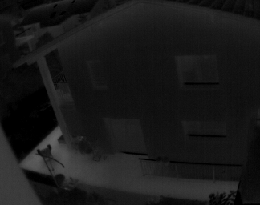
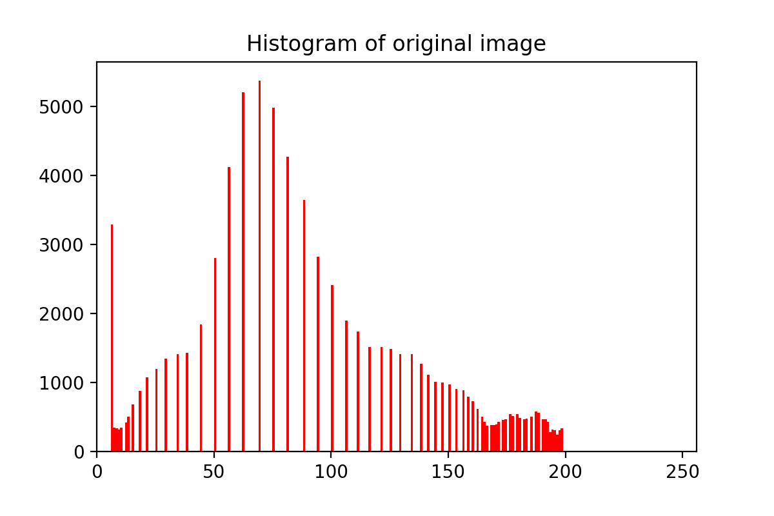
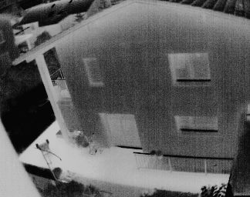
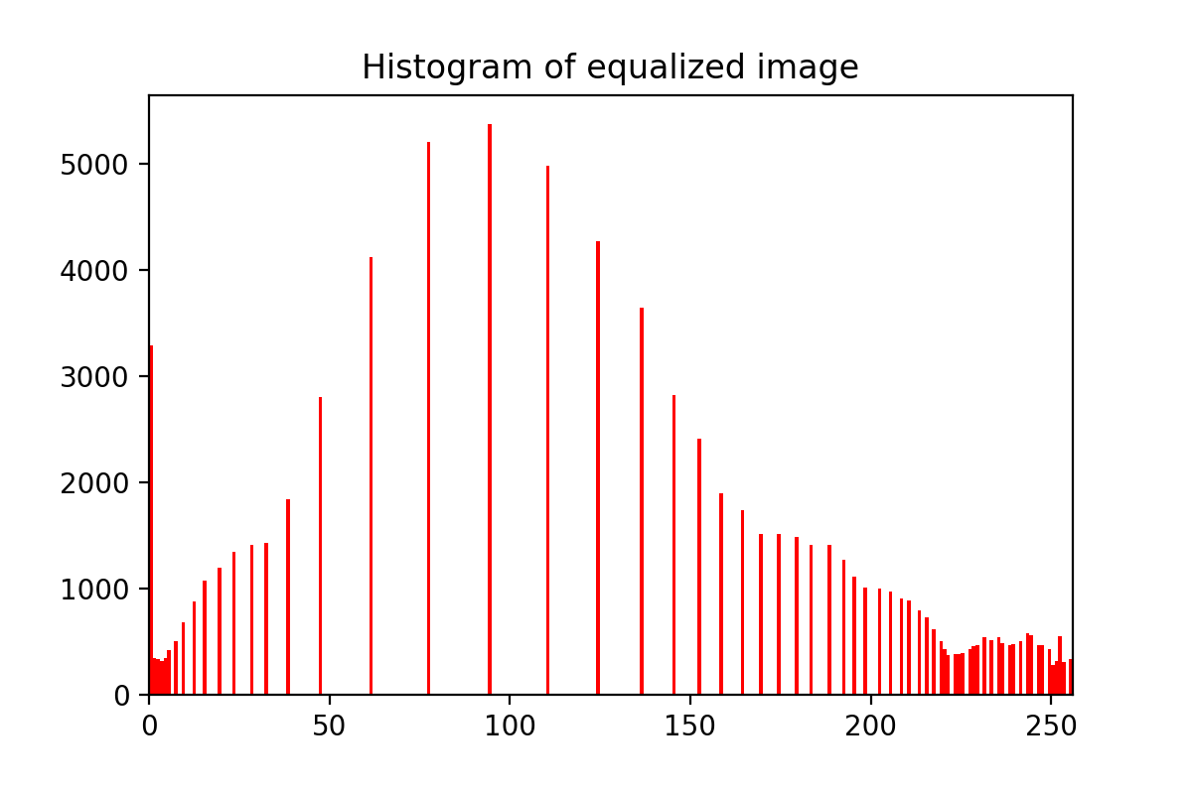
Sample Results
Original Image
Enhanced Image

Slide 8
Histogram Matching
Extension of histogram equalization.
This algorithm transforms a target image so that it’s histogram matches with the histogram of a given reference image.
Firstly, histogram equalization is performed on both, the target and the reference image, which is then followed by the matching part.
The target image histogram is manipulated such that it matches the histogram of the reference image.

Slide 9
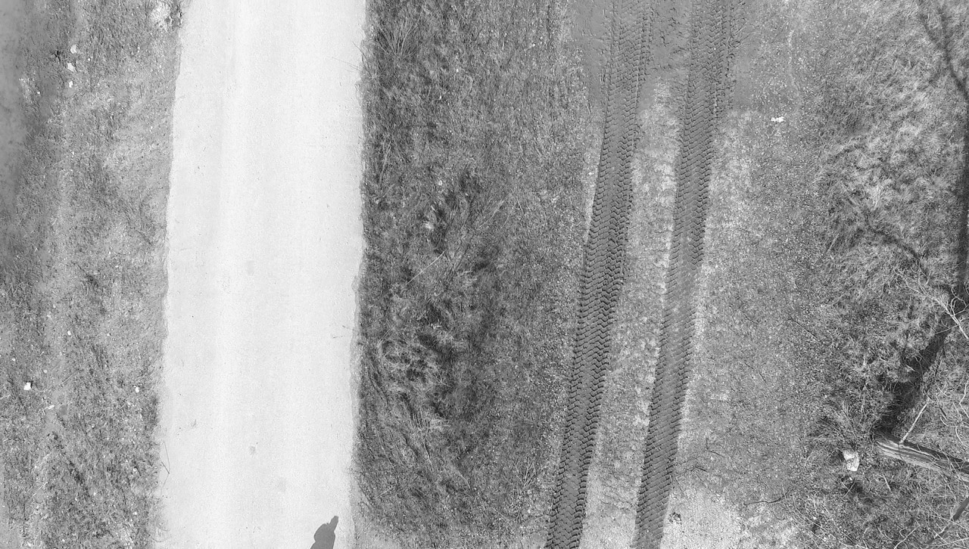
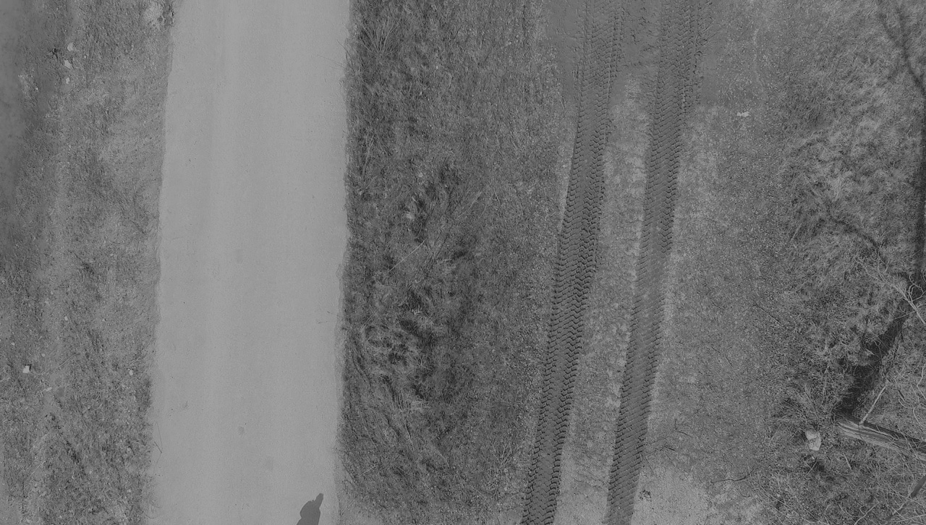
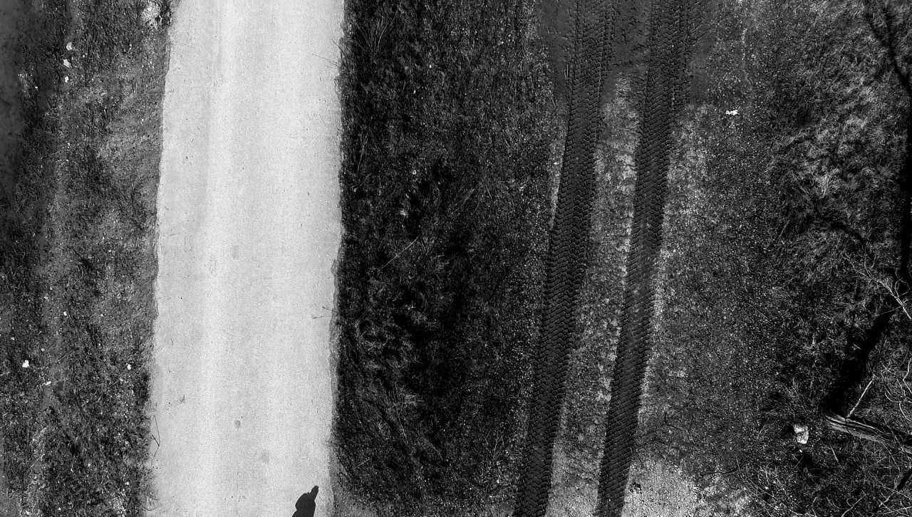
Sample Results
Target Image
Target Image after Matching
Reference Image

Slide 10
Double Plateaus Histogram Equalization
In the image histogram, there are certain grayscale values (bins) which have exceptionally high frequencies while some have very low.
Thus, we select two threshold values of frequencies, and clip the bins according to these thresholds.
The excess pixels in a high frequency bin are redistributed into the bins having low frequencies.

Slide 11
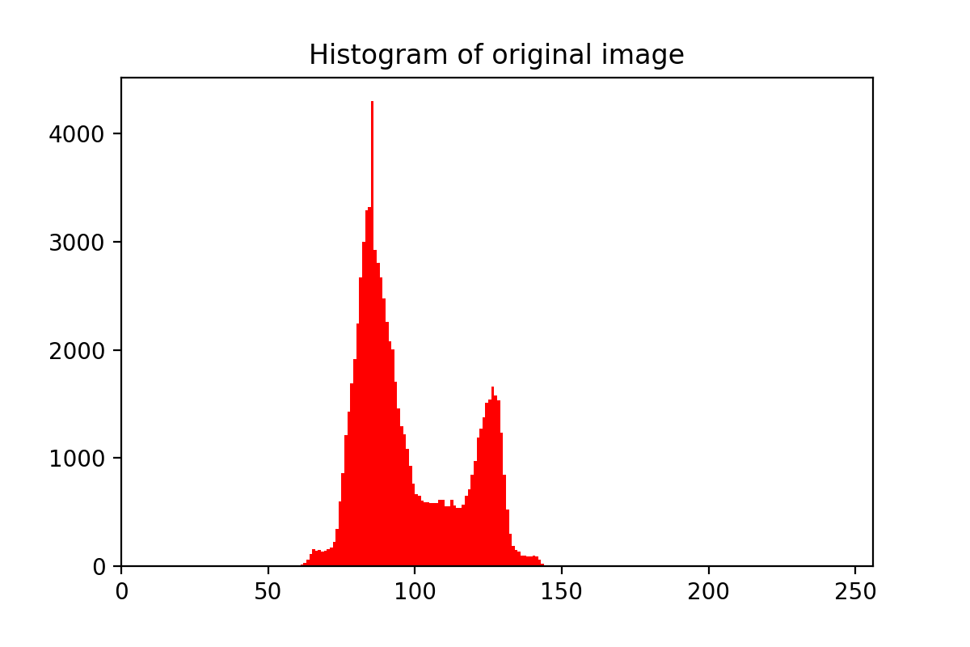
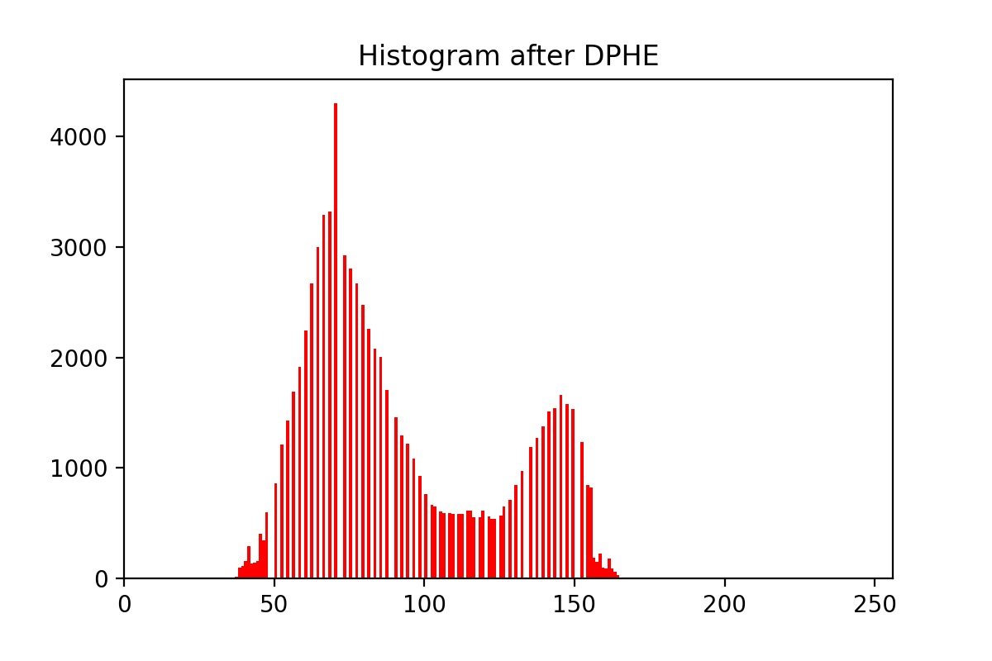
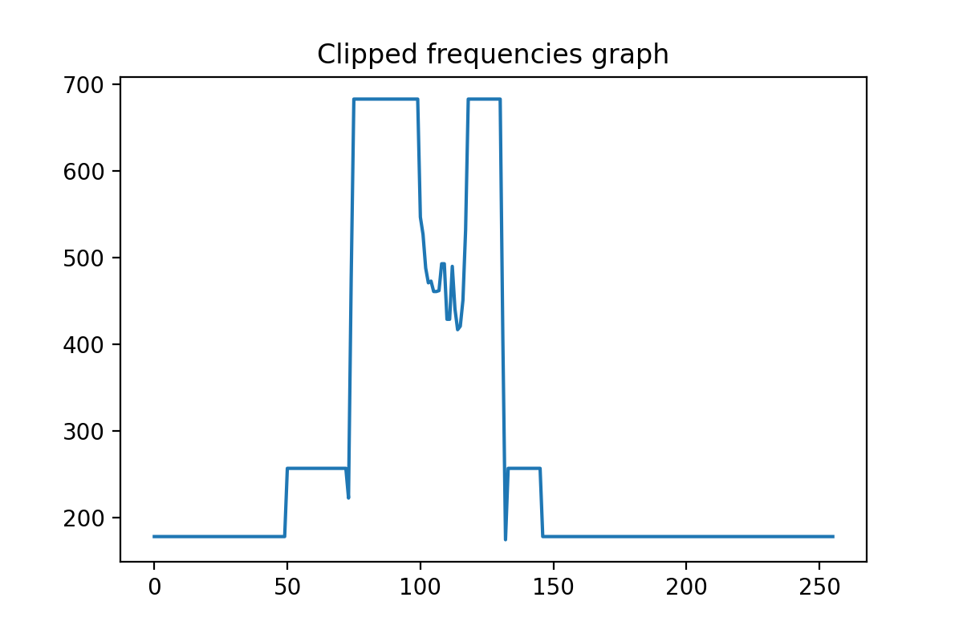
Histograms

Slide 12
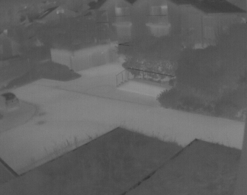
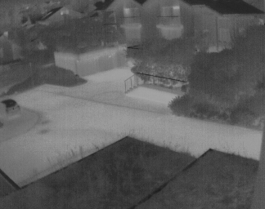
Sample Results
Original Image
Enhanced Image

Slide 13
Top-Hat Transform
In digital image processing, the algorithm extracts minute elements and details from the images.
Considering structural elements, the filter enhances bright objects of interests in a dark background.
Hence, it focuses on enhancing the light pixels in dark background.

Slide 14
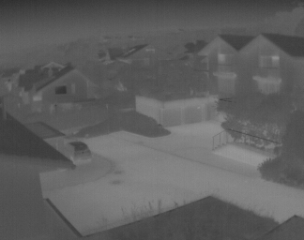
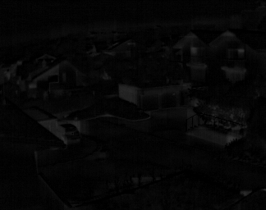
Sample Results
Original Image
Enhanced Image

Slide 15
Comparing the performance of the Algorithms
Peak Signal to Noise Ratio (PSNR): It uses the mean squared error of all the pixels between the two images to compute an expression.
The higher the PSNR value, the better the image enhancement.
We compare the PSNR value of all the 4 new images with an enhanced image obtained using an advanced, inbuilt image processing function on MATLAB.
Based on the PSNR values, Double Plateaus Histogram Equalization and Histogram Equalization were the best performing algorithms.

Slide 16
Sample Results
PSNR Value for Histogram Equalisation 14.13208046534746
PSNR Value for Histogram Matching 13.721811068771785
PSNR Value for Double Plateaus Histogram Equalisation 21.522595397489383
PSNR Value for Top Hat Transform 9.8543439512946

Slide 17
Reading the images on Vivado
Images need to be converted to binary text files to be read onto Vivado.
The entire image is flattened to a 1 D array, each element contains the pixel’s intensity value in binary 8 bit format using Python.
The file can be read using the readmemb function on Vivado.

Slide 18
Performing the algorithms on Vivado
The image is read on the testbench and passed to the design module.
The design consists of a single module:
It inputs the image as a 1 D array and converts it to a 2 D array of dimensions same as that of the original image.
The algorithm is now performed on this 2 D array that represents the image.
This image is again flattened to a 1 D image and sent as an output to the testbench.
The output is received at the testbench and written into a binary file.
This binary text file is converted to obtain the new image using python.

Slide 19
Comparing the algorithms on Vivado
Table containing the PSNR values of images obtained from both the algorithms for different images:
Image Name | PSNR after Histogram Equalization | PSNR after Double Plateaus Histogram Equalization
Image 1 | 12.703 | 23.120
Image 2 | 9.144 | 24.936
Image 3 | 14.333 | 18.820
Image 4 | 9.864 | 22.864
After performing the algorithms on different images, we can see that the PSNR values are higher for Double Plateaus Histogram Equalization in all cases.
Thus, Double Plateaus Histogram Equalization is the best amongst the ones that were used.

Slide 20
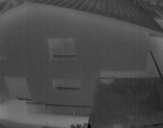
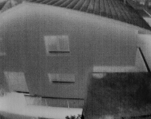
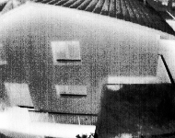

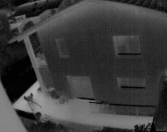
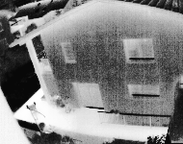
Sample Results
Original
DPHE
HE

Slide 21
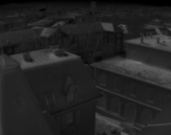
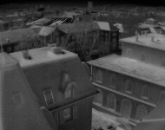
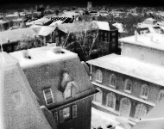
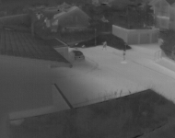
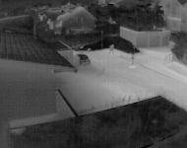
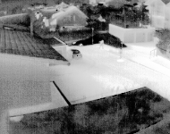
Sample Results
Original
DPHE
HE

Slide 22
Challenges faced
For the PSNR value calculations, we faced challenges in finding correct reference images to compare with our results. We decided to perform inbuilt MATLAB high level algorithms on the original image and used them as our reference images.
We had to find and use a proper convention while converting images to binary files containing the stream of all bits and vice versa.
We were not able to find proper functions for reading images onto Vivado

Slide 23
Future Scope
If we are able to perform these algorithms on each frame in a video fast enough, we can get real time video enhancement.
Applying these algorithms on Night vision goggles can improve the enhancement of images.

